Slide 1
FY 2026 Public Schools Appropriations
House Bills 251, 304, 305, 338, 396, 452, 453, 454, 465, 479, 481
Senate Bill 1213
Julie Oberle, Public School Finance

Slide 2
FY 2025, FY 2026 Public School Foundation Program - Revenues
FY 2026 Public Schools Appropriation

Slide 3
FY 2025, FY 2026 Public School Foundation Program – Statutory Expend.
FY 2026 Public Schools Appropriation

Slide 4
FY 2025, FY 2026 Public School Foundation Program – Non-Statutory Expend.
FY 2026 Public Schools Appropriation

Slide 5
FY 2025, FY 2026 Public School Foundation Program – Discretionary
FY 2026 Public Schools Appropriation

Slide 6
FY 2026 Public School Appropriation Bills
Identify the amounts from various state sources that will be distributed or expended for the period July 1, 2025, through June 30, 2026
Appropriate funds to the Divisions of Student Support, Teachers, Facilities, Central Services, Idaho Educational Services for the Deaf and the Blind, and the Idaho Digital Learning Academy
FY 2026 Public Schools Appropriation
Notes:
Section 29 in H 251

Slide 7
FY 2026 Public School Appropriation Bills, continued
Define the term "distributed" to mean moneys that are transferred to school districts, public charter schools, and the Idaho Digital Learning Academy, with no funds withheld for any other contract or administrative costs
Define the term "expended" to mean moneys that pay for the cost of contracts that provide services to school districts, public charter schools, or students or that pay for the State Department of Education's cost of administering the programs for which the moneys are allocated
FY 2026 Public Schools Appropriation
Notes:
Section 29 in H 251

Slide 8
House Bill 251, Public Schools Maintenance Budget
House Bill 251 was set early in the Session (February) and continued the majority of FY 2025’s appropriated dollars into FY 2026.
It also included a 5% CEC and an increase for health insurance.
Spending authority related to general Federal funds was increased by $9.5 million for both FY 2025 and FY 2026.
One-time expenditures and spending authority for pandemic-related Federal dollars were removed.
Adjustments for the anticipated decrease in support units, the wording for amending the administrative and classified base salaries, and other adjustments were done in trailer bills later in the Session.
FY 2026 Public Schools Appropriation
Notes:
Section 29 in H 251

Slide 9
House Bill 251, Professional Development
SECTION 8. PROFESSIONAL DEVELOPMENT - TEACHERS. Of the moneys appropriated in Section 1 of this act, $13,750,000 from the Public School Income Fund shall be distributed for professional development that supports instructors and pupil service staff to increase student learning, mentoring, and collaboration. Professional development efforts should be measurable, provide the instructors and pupil service staff with a clear understanding of their progress, be incorporated into their performance evaluations, and, to the extent possible, be included in the school district or public charter school continuous improvement plans required by Section 33-320, Idaho Code. Funding shall be distributed by a formula prescribed by the State Department of Education, and the State Department of Education shall track usage and effectiveness of professional development efforts at the state and local levels.
(No change for FY 2026. $10,850,000 for General Professional Development, $2,900,000 for Professional Development for Dyslexia.)
FY 2026 Public Schools Appropriation
Notes:
Section 29 in H 251

Slide 10
House Bill 251, Instructional and Pupil Service Compensation
SECTION 9. INSTRUCTIONAL AND PUPIL SERVICE STAFF COMPENSATION. In addition to the distribution criteria set forth in Section 33-1004B(9)(f), Idaho Code, an additional $6,359 shall be allocated to each cell for residential, professional, and advanced professional rungs. These funds must be used for instructional and pupil service compensation. Funding shall be distributed in combination with other career ladder allocations for the period July 1, 2025, through June 30, 2026. School districts and public charter schools shall report to the State Department of Education on the allocation of these funds for instructional and pupil service compensation. The State Department of Education shall provide a report to the Joint Finance-Appropriations Committee by January 5, 2026, on the allocations made by school districts and public charter schools. The format of the report and the contents therein shall be determined by the Legislative Services Office Budget and Policy Analysis Division.
(Repeat of language from last two years.)
FY 2026 Public Schools Appropriation
Notes:
Section 29 in H 251

Slide 11
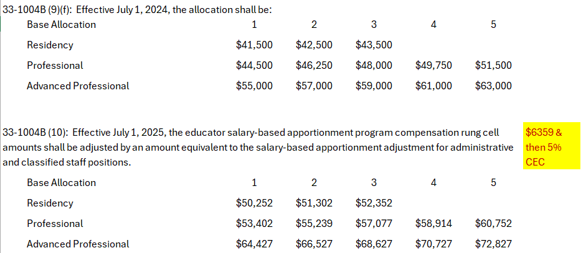
House Bill 251, Instructional and Pupil Service Compensation, cont.
FY 2026 Public Schools Appropriation
Notes:
Section 29 in H 251

Slide 12
Other – Career Ladder Minimums
33-1004E - Career Ladder Minimums for FY 2026
Residency: No full-time Instructional/Pupil Service staff on the residency compensation rung shall be paid less than the R1 allocation
  33-1004E. District’s salary-based apportionment. Each district shall be entitled to a salary-based apportionment calculated as provided in this section. (1)…No full-time instructional staff member or pupil service staff member on the residency compensation rung shall be paid less than the minimum dollar amount on the career ladder residency compensation rung pursuant to section 33-1004B, Idaho Code, for the applicable fiscal year.
Professional: No full-time Instructional/Pupil Service staff on the Professional rung shall be paid less than the P1 allocation
  (2) Effective July 1, 2022, no full-time instructional staff member or pupil service staff member on the professional or advanced professional compensation rung shall be paid less than the minimum dollar amount on the career ladder professional compensation rung pursuant to section 33-1004B, Idaho Code, for the applicable fiscal year.
FY 2026 Public Schools Appropriation
Notes:
Section 29 in H 251

Slide 13
Other – Career Ladder Minimums, continued
33-1004E - Career Ladder Minimums for FY 2026
Advanced Professional: No full-time Instructional/Pupil Service staff on the Advanced Professional rung shall be paid less than the AP1 allocation (new for FY 2026)
  (3) Effective July 1, 2025, no full-time instructional staff member or pupil service staff member on the advanced professional compensation rung shall be paid less than the minimum dollar amount on the advanced professional compensation rung pursuant to section 33-1004B, Idaho Code, for the applicable fiscal year.
FY 2026 Public Schools Appropriation
Notes:
Section 29 in H 251

Slide 14
House Bill 251, Discretionary Funds
SECTION 10. DISCRETIONARY FUNDS. Notwithstanding any law to the contrary, for the period July 1, 2025, through June 30, 2026, it is estimated that the appropriation of state funds to the Public Schools Educational Support Program's Division of Operations as part of the Student Support Division will result in total discretionary funds of $23,472 per support unit that are to be used at the discretion of the school district or charter school.
(No change for FY 2026. FY 2024 appropriated $19,537 per support unit and FY 2025 appropriated $23,472 per support unit.)
FY 2026 Public Schools Appropriation
Notes:
Section 29 in H 251

Slide 15
House Bill 251, Health Benefit and Insurance Funds
SECTION 11. HEALTH BENEFIT AND INSURANCE FUNDS. Notwithstanding any law to the contrary, for the period July 1, 2025, through June 30, 2026, it is estimated that the appropriation of state funds to the Public Schools Educational Support Program's Division of Operations as part of the Student Support Division will result in total health benefits or insurance and health benefits-related funds of $21,902 per support unit to be used to off set the costs of health, vision, and dental benefits or insurance offered to school employees.
(FY 2025 appropriated $20,150 per support unit, an increase of $1,752 to $21,902 per support unit for FY 2025)
FY 2026 Public Schools Appropriation
Notes:
Section 29 in H 251

Slide 16
House Bill 251, Health Benefit and Insurance Funds, continued
If the distribution provided for health, vision, and dental benefits or insurance is in excess of the individual school district’s or charter school's actual costs, the excess funds may then be used at the school district's or charter school's discretion. Further, the State Department of Education shall work with the Legislative Services Office Budget and Policy Analysis Division and the Division of Financial Management to determine the information that the State Department of Education shall collect on school districts' and charter schools' health, vision, and dental benefits or insurance plan information and costs, including but not limited to actual insurance premium costs, premium percentage increases, and health insurance revenues and expenditures from all fund sources.
FY 2026 Public Schools Appropriation
Notes:
Section 29 in H 251

Slide 17
House Bill 251, Classroom Technology
SECTION 12. CLASSROOM TECHNOLOGY. Of the moneys appropriated in Section 2 of this act, $36,500,000 from the Public School Income Fund shall be distributed for classroom technology, classroom technology infrastructure, wireless technology infrastructure, and learning management systems that assist teachers and students in effective and efficient instruction or learning. Funding shall be distributed based on a formula prescribed by the State Department of Education. Moneys so distributed shall be used to implement and operate a learning management system of each school district's or public charter school's choice. A learning management system shall include integration with a school district's or public charter school's student information system and shall administer, monitor, and document student and classroom levels of learning. The State Department of Education shall verify that school districts and public charter schools are using funds to purchase a learning management system that is compliant with these standards.
(no change for FY 2026)
FY 2026 Public Schools Appropriation
Notes:
Section 29 in H 251

Slide 18
House Bill 251, Exemption from Transfer Limitations
SECTION 13. EXEMPTIONS FROM PROGRAM TRANSFER LIMITATIONS. For the period July 1, 2025, through June 30, 2026, the State Department of Education is hereby granted the authority to transfer appropriations among the Teachers, Student Support, Facilities, and Idaho Digital Learning Academy divisions of the Public Schools Educational Support Program, in any amount necessary, to comply with the public school funding provisions of appropriations and Idaho Code. Additionally, appropriations may be transferred from the Division of Central Services to the other divisions of the Public Schools Educational Support Program.
(no change for FY 2026)
FY 2026 Public Schools Appropriation
Notes:
Section 29 in H 251

Slide 19
House Bill 251, Cigarette, Tobacco, and Lottery Distribution
SECTION 14. CIGARETTE, TOBACCO, AND LOTTERY DISTRIBUTION. Notwithstanding any provision of law to the contrary, of the moneys appropriated in Section 2 of this act, up to $4,324,900 from available cigarette, tobacco, and lottery income tax revenue funds accruing, appropriated, or distributed to the Public School Income Fund pursuant to Sections 63-2506, 63-2552A, and 63-3067, Idaho Code, for the period July 1, 2025, through June 30, 2026, shall be distributed to school districts and charter schools through a combination of a base amount of $2,000 plus a prorated amount based on the prior year's average daily attendance. Such funds shall be used to develop and implement school safety improvements and/or to facilitate and provide substance abuse prevention programs in the public school system.
(no change for FY 2026)
FY 2026 Public Schools Appropriation
Notes:
Section 29 in H 251

Slide 20
House Bill 251, Coursework (Remediation)
SECTION 15. COURSEWORK. Of the moneys appropriated in Section 2 of this act, $4,715,000 shall be distributed for coursework for students failing to achieve proficiency on Idaho's standards-based achievement tests in dollar amounts determined by the State Department of Education. The State Department of Education shall report to the Joint Finance-Appropriations Committee and the Senate Education and House Education committees by no later than January 5, 2026, on the uses of funds and effectiveness of the programs and efforts.
(no change for FY 2026)
FY 2026 Public Schools Appropriation
Notes:
Section 29 in H 251

Slide 21
House Bill 251, Open Enrollment Information
SECTION 16. OPEN ENROLLMENT INFORMATION. The State Department of Education shall withhold the November payment for any school district that is not in compliance with the provisions of Section 33-1409, Idaho Code, until such time as the school district becomes compliant.
(no change for FY 2026)
FY 2026 Public Schools Appropriation
Notes:
Section 29 in H 251

Slide 22
House Bill 251, English Proficiency
SECTION 17. ENGLISH PROFICIENCY. Pursuant to Section 33-1617, Idaho Code, of the moneys appropriated in Section 2 of this act, $4,820,000 shall be distributed for support of students in English language learner programs as follows:
(1) The State Department of Education shall distribute $4,370,000 to school districts and charter schools pro rata based on the population of English language learners under criteria established by the department.
(2) The State Department of Education shall distribute $450,000 for a competitive grant program to assist school districts and charter schools in which English language learners are not reaching statewide accountability interim targets or long-term goals, as defined by federal law. This amount shall be distributed annually in three-year grant cycles, contingent on appropriation and the ability of grantees to meet program objectives.
FY 2026 Public Schools Appropriation
Notes:
Section 29 in H 251

Slide 23
House Bill 251, English Proficiency, continued
The State Department of Education shall develop the program elements and objectives governing the use of these funds and include a program evaluation component.
The purpose of these funds is to improve student English language skills to allow for better access to the educational opportunities offered in public schools. The State Department of Education shall report to the Joint Finance-Appropriations Committee and the Senate Education and House Education committees by no later than January 5, 2026, on the program design, use of funds, and program effectiveness.
(no change for FY 2026)
FY 2026 Public Schools Appropriation
Notes:
Section 29 in H 251

Slide 24
House Bill 251, Advanced Opportunities Courses and Program Evaluation
SECTION 18. ADVANCED OPPORTUNITIES COURSES AND PROGRAM EVALUATION. The State Department of Education shall compile information concerning the number of students enrolling in advanced opportunities courses according to the provisions of Chapter 46, Title 33, Idaho Code, whether coursework is successfully completed, and total expenditures for fiscal year 2025. As nearly as practicable, the report shall contain information about enrollment of this student population in postsecondary education. A report containing such information shall be posted on the website of the State Department of Education no later than January 5, 2026.
(no change for FY 2026)
FY 2026 Public Schools Appropriation
Notes:
Section 29 in H 251

Slide 25
House Bill 251, Transfers to the Commission on Hispanic Affairs and Idaho State Police
SECTION 19. PUBLIC SCHOOL INCOME FUND TRANSFER TO COMMISSION ON HISPANIC AFFAIRS. There is hereby appropriated and the Office of the State Controller shall transfer in accordance with Section 63-2552A(2), Idaho Code, on July 1, 2025, or as soon thereafter as practicable, $80,000 from the Public School Income Fund to the Commission on Hispanic Affairs Miscellaneous Revenue Fund to be used for substance abuse prevention efforts in collaboration with the State Department of Education.
SECTION 20. PUBLIC SCHOOL INCOME FUND TRANSFER TO THE IDAHO STATE POLICE. There is hereby appropriated and the Office of the State Controller shall transfer in accordance with Section 63-2552A(2), Idaho Code, on July 1, 2025, or as soon thereafter as practicable, $200,000 from the Public School Income Fund to the Idaho State Police Miscellaneous Revenue Fund for the purpose of increasing toxicology lab capacity in Forensic Services.
(no change for FY 2026)
FY 2026 Public Schools Appropriation
Notes:
Section 29 in H 251

Slide 26
House Bill 251, Digital Content and Curricula
SECTION 21. DIGITAL CONTENT AND CURRICULA. Of the funds appropriated in Section 2 of this act, $1,600,000 shall be distributed by the State Department of Education to school districts and public charter schools to purchase digital content and curricula of their choice. Funding will be distributed subject to Section 33-4804(2), Idaho Code.
(no change for FY 2026)
FY 2026 Public Schools Appropriation
Notes:
Section 29 in H 251

Slide 27
House Bill 251, Idaho Digital Learning Academy
SECTION 22. IDAHO DIGITAL LEARNING ACADEMY. The Idaho Digital Learning Academy (IDLA), created pursuant to Chapter 55, Title 33, Idaho Code, shall utilize state-appropriated funds for the period July 1, 2025, through June 30, 2026, to achieve the following:
(1) Tuition charged by IDLA to Idaho school districts and charter schools shall not exceed $75.00 per enrollment. (Language later amended by Section 6 of H 452 to $40.00 per enrollment)
(2) Provide remedial coursework for students failing to achieve proficiency in one or more areas of Idaho's standards-based tests.
(3) Pursuant to State Board of Education rule, IDAPA 08.02.03, provide advanced opportunities, including access to dual credit courses, for students.
The preceding list shall not be construed as excluding other instruction and training that may be provided by the Idaho Digital Learning Academy.
(No changes to language in H 251; H 452 reduced tuition to $40 per enrollment for FY 2026)
FY 2026 Public Schools Appropriation
Notes:
Section 29 in H 251

Slide 28
House Bill 251, Program Support (Central Services)
SECTION 23 through SECTION 27 – Central Services appropriations for Program Support (Math, EL, Remediation, Student Assessments, Professional Development, Content & Curriculum, and Technology).
(no change for FY 2026)
FY 2026 Public Schools Appropriation
Notes:
Section 29 in H 251

Slide 29
Trailer Bills, Other Public School Finance Related Bills
Trailer Bills
House Bill 465: Adjustments related to the Division of Student Support
House Bill 454: Adjustments related to the Division of Teachers
House Bills 453, 304 and 481: Adjustments related to the Division of Facilities
Senate Bill 1213: Adjustments related to Central Services
House Bill 452: Adjustments related to the Division of Idaho Digital Learning Academy
Other Bills
House Bill 305: Adjustments related to Use-it-or-Lose-it
House Bill 396: Elimination of $7.5 million reduction for Transportation funding
House Bill 338: Modifies the Public School Facilities Cooperative Program
House Bill 479: Tax Relief Fund Transfer
FY 2026 Public Schools Appropriation
Notes:
Section 29 in H 251

Slide 30
House Bill 465 – Division of Student Support, District’s Salary-Based Apportionment (Administrators)
SECTION 4. …33-1004E (6) To determine the apportionment for district administrative staff, first determine the district average experience and education index by placing all eligible certificated administrative employees on the statewide index provided in section 33-1004A, Idaho Code. The resulting average is the district index. If the district does not employ any administrative staff, the district administrative index shall equal the statewide average index for purposes of calculating administrative salary-based apportionment. On and after July 1, 2025, the district administrative staff index shall be multiplied by the base salary of $44,446 $46,668. The amount so determined shall be multiplied by the district staff allowance for administrative staff determined as provided in section 33-1004(4), Idaho Code. The resulting amount is the district's salary-based apportionment for administrative staff.
(5% increase from FY 2025)
FY 2026 Public Schools Appropriation
Notes:
Section 29 in H 251

Slide 31
House Bill 465 - Division of Student Support, District’s Salary-Based Apportionment (Classified)
SECTION 4. …33-1004E (7) On and after July 1, 2025, to determine the apportionment for classified staff, multiply $39,966 $41,964 by the district classified staff allowance determined as provided in section 33-1004(5), Idaho Code. The amount so determined is the district's apportionment for classified staff.
(5% increase from FY 2025)
FY 2026 Public Schools Appropriation
Notes:
Section 29 in H 251

Slide 32
House Bill 465 – Division of Student Support, Federal Funding Restrictions
SECTION 7. FEDERAL FUNDING RESTRICTIONS. Pursuant to Section 67-3511(2), Idaho Code, legislative appropriations shall not be transferred from one fund to another fund unless expressly approved by the Legislature. Appropriations made pursuant to this act contingent on anticipated federal funding, grants, or programs shall not be supplanted by state funds in the event of any reduction or elimination of such federal support without legislative approval. The agency receiving the appropriation shall take all necessary actions to ensure that the state is not obligated to replace lost federal funds. Pursuant to Section 67-1917, Idaho Code, the agency will submit an inventory of federal funds utilized by the agency. State funds appropriated to satisfy match requirements for federal funds shall be reverted to the maximum extent possible if federal funds requiring match are reduced or eliminated. The agency shall promptly notify the Budget and Policy Analysis Division of the Legislative Services Office of any significant changes related to federal funding, grants, or programs. This does not apply to standard federal funding adjustments that take place within an agency's cost allocation plan or indirect expenditure plan for indirect costs and agency support staff, FMAP adjustments, or entitlement programs.
(new language for FY 2026)
FY 2026 Public Schools Appropriation
Notes:
Section 29 in H 251

Slide 33
House Bill 465 – Division of Student Support, Age Compliance
SECTION 8. AGE COMPLIANCE. The State Department of Education shall verify compliance with Section 33-201, Idaho Code, prior to distributing any state funds to a school district or public charter school for services related to children. Verification shall occur prior to distributing funds in the November payment pursuant to Section 33-1009, Idaho Code.
(new language for FY 2026)
FY 2026 Public Schools Appropriation
Notes:
Section 29 in H 251

Slide 34
House Bill 465 – Division of Student Support, Age Compliance, cont.
33-201. School age. The services of the public schools of this state are extended to any acceptable person of school age. "School age" is defined as including all persons resident of the state, between the ages of five (5) and twenty-one (21) years. For the purposes of this section, the age of five (5) years shall be attained when the fifth anniversary of birth occurs on or before the first day of September of the school year in which the child is to enroll in kindergarten. For a child enrolling in the first grade, the age of six (6) years must be reached on or before the first day of September of the school year in which the child is to enroll. Any child of the age of five (5) years who has completed a private or public out-of-state kindergarten for the required four hundred fifty (450) hours but has not reached the "school age" requirement in Idaho shall be allowed to enter the first grade.
For resident children with disabilities who qualify for special education and related services under the federal individuals with disabilities education act (IDEA) and subsequent amendments thereto, and applicable state and federal regulations, "school age" shall begin at the attainment of age three (3) and shall continue through the semester of school in which the student attains the age of twenty-one (21) years.
FY 2026 Public Schools Appropriation
Notes:
Section 29 in H 251

Slide 35
House Bill 454 - Division of Teachers
SECTION 1. In addition to any other appropriation provided by law, there is hereby appropriated to the Public Schools Educational Support Program's Division of Teachers an additional $1,630,500 from the Public School Income Fund for the period July 1, 2025, through June 30, 2026.
SECTION 2. There is hereby appropriated and the Office of the State Controller shall transfer $1,630,500 from the General Fund to the Public School Income Fund July 1, 2025, or as soon thereafter as practicable for the period July 1, 2025, through June 30, 2026.
SECTION 3. Of the additional amounts appropriated in Section 1 of this act for the Public School Support Program's Division of Teachers, $1,630,500 shall be considered expended from the General Fund for the period July 1, 2025, through June 30, 2026.
SECTION 4. An emergency existing therefor, which emergency is hereby declared to exist, this act shall be in full force and effect on and after July 1, 2025.
(adjusts maintenance appropriation (H 251) for decreased support units and career ladder movement)
FY 2026 Public Schools Appropriation
Notes:
Section 29 in H 251

Slide 36
House Bill 453 - Division of Facilities
SECTION 3. There is hereby appropriated and the Office of the State Controller shall transfer $586,300 from the General Fund to the Public School Income Fund on July 1, 2025, or as soon thereafter as practicable for the period July 1, 2025, through June 30, 2026.
SECTION 5. Of the amounts reduced in Section 2 of this act for the Public Schools Educational Support Program's Division of Facilities, $2,156,400 shall be reduced from the amounts considered expended from the School Districts Facilities Fund for the period July 1, 2025, through June 30, 2026.
(adjusts Division of Facilities funding in H 251 for an anticipated increase in charter school enrollment, increasing the charter school facilities distribution; reduces revenues for an anticipated decrease in lottery dividends)
FY 2026 Public Schools Appropriation
Notes:
Section 29 in H 251

Slide 37
House Bills 304 and 481 – Division of Facilities, School District Facilities Fund
House Bill 304: Appropriates an additional $50 million to the School District Facilities Fund from the Property Tax Relief Fund
Working with Legislative Services and the Governor’s Office to determine if the transfer begins in FY 2026 or FY 2027
House Bill 481: Returns the School District Facilities Fund to being continuously appropriated
FY 2026 Public Schools Appropriation
Notes:
Section 29 in H 251

Slide 38
Senate Bill 1213 – Division of Central Services, Funding for Professional Development related to Literacy
SECTION 4. STATEWIDE TRAINING FOR EARLY LITERACY. Of the moneys appropriated in Section 1 of this act, $5,000,000 shall be expended for intensive professional development and coaching supports that leverage literacy experts who are approved by the State Department of Education and trained in the science of reading in conformance with Section 33-1807(7), Idaho Code. The State Department of Education shall provide all kindergarten through grade 3 teachers this professional development on a three-year cycle, while extending the training to elementary administrators and other support staff as time and resources allow. Additionally, the State Department of Education shall prioritize these professional development services to teachers and administrators in underperforming schools as calculated in the bottom 25% based on the most recent spring Idaho Reading Indicator scores. Support for low performing schools may include pay for success models provided under Section 33-125B, Idaho Code, for turnaround school service providers. The format
and content of No later than January 5, 2026, the State Department of Education shall report to the Budget and Policy Analysis Division of the Legislative Services Office on the distribution, expenditure, and results of these funds. The format and content of the report shall be determined in consultation with the State Department of Education and the Budget and Policy Analysis Division of the Legislative Services Office.
FY 2026 Public Schools Appropriation
Notes:
Section 29 in H 251

Slide 39
House Bill 452 – Division of Idaho Digital Learning Academy (IDLA), Add’l Appropriation
SECTION 1. In addition to any other appropriation provided by law, there is hereby appropriated to the Public Schools Educational Support Program's Division of the Idaho Digital Learning Academy an additional $3,577,600 to be expended from the Public School Income Fund for the period July 1, 2025, through June 30, 2026.
(increases the appropriation in H 521 for an anticipated increase in IDLA enrollments and an increased amount funded per enrollment)
FY 2026 Public Schools Appropriation
Notes:
Section 29 in H 251

Slide 40
House Bill 452 – Division of Idaho Digital Learning Academy, Report Required
SECTION 5. IDAHO DIGITAL LEARNING ACADEMY FUNDING PROCESS. The Second Regular Session of the Sixty-eighth Idaho Legislature shall consider policies to verify funds provided by the state for match of individual student enrollment, which may include changing how the state, districts, charters, and public are billed for courses at the Idaho Digital Learning Academy (IDLA). To assist the Legislature, IDLA shall provide a report to the Budget and Policy Analysis Division of the Legislative Services Office that details the cost of providing each available service, how IDLA determined the budgeted amount for each service or class, and a detailed report on budgeted and expenditure data for costs associated with operating IDLA. Provided services shall include data on class type, grade level, number of and type of courses enrolled in, and other defining factors. The report shall be provided no later than August 1, 2025, based on data from the 2024-2025 school year. The format and content of the report will be determined in consultation with the Budget and Policy Analysis Division of the Legislative Services Office.
(new language for FY 2026)
FY 2026 Public Schools Appropriation
Notes:
Section 29 in H 251

Slide 41
House Bill 452 – Division of Idaho Digital Learning Academy, Tuition
SECTION 6. That Section 22 of House Bill No. 251, as enacted by the First Regular Session of the Sixty-eighth Idaho Legislature, be, and the same is hereby amended to read as follows:
SECTION 22. IDAHO DIGITAL LEARNING ACADEMY. The Idaho Digital Learning Academy (IDLA), created pursuant to Chapter 55, Title 33, Idaho Code, shall utilize state-appropriated funds for the period July 1, 2025, through June 30, 2026, to achieve the following:
(1) Tuition charged by IDLA to Idaho school districts and charter schools shall not exceed $40.00 per enrollment.
(2) Provide remedial coursework for students failing to achieve proficiency in one or more areas of Idaho's standards-based tests.
(3) Pursuant to State Board of Education rule, IDAPA 08.02.03, provide advanced opportunities, including access to dual credit courses, for students.
The preceding list shall not be construed as excluding other instruction and training that may be provided by the Idaho Digital Learning Academy.
(amended language for FY 2026; $75 tuition charged in prior years)
FY 2026 Public Schools Appropriation
Notes:
Section 29 in H 251

Slide 42
House Bill 452 – Division of Idaho Digital Learning Academy, Funding
SECTION 7. That Section 33-1020, Idaho Code, be, and the same is hereby amended to read as follows:
33-1020. IDAHO DIGITAL LEARNING ACADEMY FUNDING. (1) An amount of four hundred forty-five dollars ($445) per enrollment shall be distributed to support the Idaho Digital Learning Academy, created pursuant to chapter 55, title 33, Idaho Code. For the purposes of this section, an "enrollment" shall be counted each time an Idaho school age child enrolls in an Idaho Digital Learning Academy class and continues to be enrolled in such class past the deadline to withdraw, where such withdrawal would not result in the class appearing on such child's transcript in any way. A single child enrolled in multiple classes shall count as multiple enrollments. Summer enrollments shall be included in the fiscal year that begins that summer.
(increases the reimbursement rate from $430 in FY 2025)
FY 2026 Public Schools Appropriation
Notes:
Section 29 in H 251

Slide 43
Other – House Bill 305, Use-it-or-Lose-it
Section 1 of House Bill 305
33-1004. STAFF ALLOWANCE
33-1004(6)(g) - A district may employ nine and one-half percent (9.5%) fewer positions than funded pursuant to subsections (2) and (3) of this section, without a reduction in the number of funded positions being imposed. Beginning in fiscal year 2016, this figure shall be reduced by one percent (1%) each year for each school district in which the average class size, as determined from prior fiscal year data reported to the state department of education, was at least one (1) student greater than the statewide average class size. The state department of education shall report to the legislature every February, beginning in 2015, on the reductions scheduled to take place in this figure, by school district, in the ensuing fiscal year.
FY 2026 Public Schools Appropriation
Notes:
Section 29 in H 251

Slide 44
Other – House Bill 396, $7,500,000 Transportation Reduction
33-1006 – TRANSPORTATION SUPPORT PROGRAM
Section 1…(8) The total moneys paid to school districts and public charter schools for eligible transportation costs shall be reduced by a proportionate amount to equal seven million five hundred thousand dollars ($7,500,000) and shall be used as discretionary spending.
FY 2026 Public Schools Appropriation
Notes:
Section 29 in H 251

Slide 45
Other – House Bill 338, Public School Facilities Cooperative Funding Program Modifications (School Districts only)
The Public School Facilities Cooperative Funding Program, per Idaho Code 33-909, has been around for many years but has only been used by two school districts to remedy safety issues
House Bill 338 modifies the language in Idaho Code 33-909 to make the funds more accessible to school districts
Per the Statement of Purpose, the fund is intended to provide a “state backstop” for remediating unsafe school facilities should local efforts fail
The language in Idaho Code 33-911 was also modified, changing the “waterfall” of School District Facility Fund uses to the following:
33-911(2): Moneys in the fund must be used by a school district in the following order of priority:
(a) Payment of existing school bonds authorized pursuant to chapter 11, title 33, Idaho Code, and issued prior to July 1, 2025;
(b) Payments required pursuant to section 33-909, Idaho Code;
(c) Payments of existing school bonds authorized pursuant to chapter 11, title 33, Idaho Code, and issued on or after July 1, 2025;
(d) Payment of supplemental school levies authorized pursuant to section 33-802, Idaho Code, excluding indefinite term supplemental levies described in section 33-802(5), Idaho Code;
(e) Payment of school plant facility levies authorized pursuant to sections 33-804 and 33-804A, Idaho Code; and
(f) Any moneys that remain following the payments provided in paragraphs (a) through (c) of this subsection may be: used for construction of a new school facility, renovation, or maintenance needs; used to secure and make payments on a new school facilities bond; or saved in a reserve account by the school district for future school facility needs. Uses of funds shall include regular and routine facilities maintenance, including preventive maintenance, building repairs, and building security, and periodic major facilities projects that involve planning, design, construction, renovation, retrofitting, and replacing of buildings and building systems, components, and features, as well as site acquisition, site improvements, and new construction.
This will be covered in more detail during the Post Legislative workshops to be held in May.
FY 2026 Public Schools Appropriation
Notes:
Section 29 in H 251

Slide 46
Other – House Bill 479, Tax Relief Fund Transfer (School Districts only)
H 479 added language to Idaho Code 57-811 – Tax Relief Fund to allow the State Controller until August 31 to transfer funds to the school district facilities fund.
August 31 falls on a Sunday, so the transfer could be delayed until Monday, September 1, which is a holiday, meaning the transfer could be delayed until September 2.
While we will, of course, prioritize the allocation and distribution of available School District Facilities Funds, please be prepared to notify your county clerk(s) that an extension could be required to file your L-2 form.
FY 2026 Public Schools Appropriation
Notes:
Section 29 in H 251

Slide 47
FY 2026 Public School Foundation Program
FY 2026 Public Schools Appropriation
Notes:
Section 29 in H 251

Slide 48
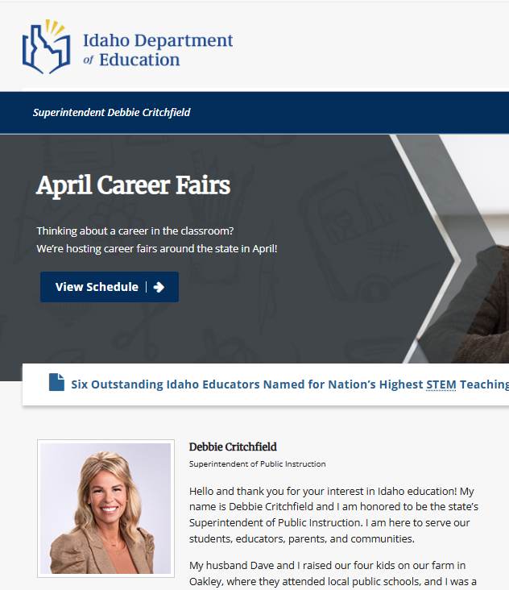

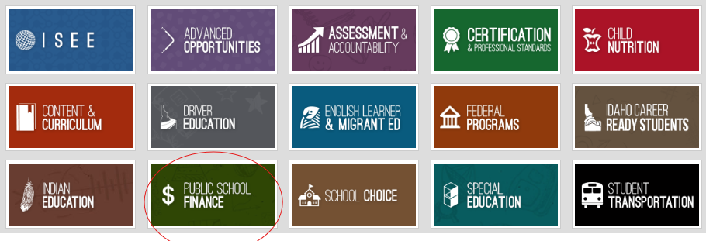
FY 2026 Public School Budgeting - 2025-2026 Budget Forms
http:www.sde.Idaho.gov/
Once on the department’s website at www.sde.Idaho.gov, click on the Public School Finance box at the bottom of the page.
FY 2026 Public Schools Appropriation
Notes:
Section 29 in H 251

Slide 49
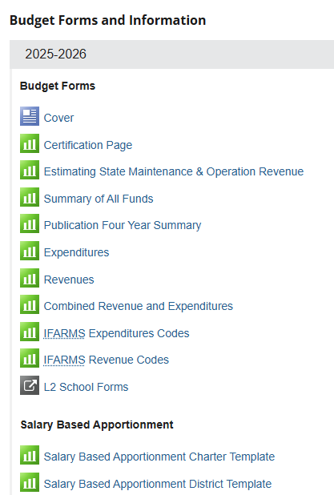
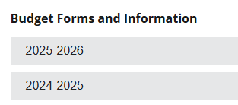
FY 2026 Public School Budgeting - 2025-2026 Budget Forms, cont.
Go to Budget Forms and Information and
select 2025-2026.
FY 2026 Public Schools Appropriation
Notes:
Section 29 in H 251

Slide 50
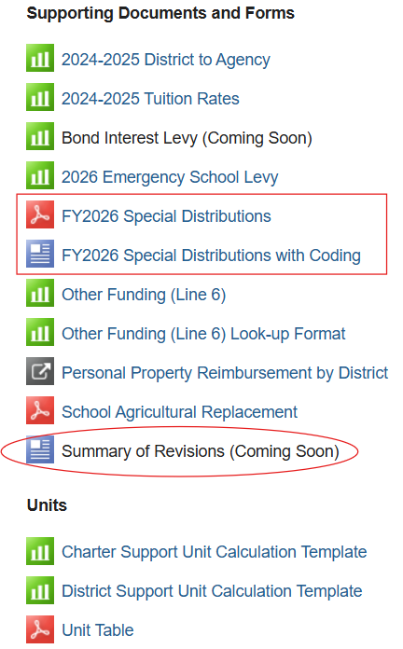
FY 2026 Public School Budgeting - 2025-2026 Forms & Information, cont.
PLEASE tell us if you see any errors.
Any revisions made after the initial posting of the 2025-2026 budget forms will be summarized on a Summary of Revisions document included in the Supporting Documents and Forms section. It will include the budget form impacted, the date of the revision, and a summary of the revision.
FY 2026 Public Schools Appropriation
Notes:
Section 29 in H 251

Slide 51
FY 2026 Public School Budgeting – Special Distributions
Most of the dollars we distribute to you are based on the information you upload via ISEE, including data for mid-term & best 28 week average daily attendance, enrollment, and Instructional / Pupil Service FTE
  Critical that you report accurate data via ISEE in compliance with state laws and board rules
  If you aren’t sure about something – reach out to your regional ISEE Technical Coordinator or Public School Finance
  It is essential that you make it a practice to review your data before and after it has been uploaded and make corrections ASAP
FY 2026 Public Schools Appropriation
Notes:
Section 29 in H 251

Slide 52
FY 2026 Public School Budgeting – Advanced Opportunities
Advanced Opportunities (33-4602, I.C.)
Advanced Opportunities – Funding is available to pay for overload courses, dual credit courses, postsecondary credit-bearing exams, career technical certification exams, CTE workforce training, college entrance exams, preliminary college entrance exams, and proctoring fees. Every public school student in grades 7-12 is allocated $4,625.00 for these purposes. In most cases, these funds will be paid directly to Idaho public post-secondary institutions and IDLA. The school district or charter school will be the recipient of these funds if:
  The school district or charter school is the provider of an overload course.
  A course taken by a student is through a private institution or outside the state of Idaho. The school district or charter school will be expected to forward these funds to either the institution or to the family.
  Students are requesting funds for an examination (AP, IB, CLEP, and CTE). The school district or charter school will likely be billed for this activity by the exam provider, or may need to reimburse the family.
FY 2026 Public Schools Appropriation
Notes:
Section 29 in H 251

Slide 53
FY 2026 Public School Budgeting – Advanced Opportunities, cont.
Advanced Opportunities (33-4602, I.C.)
Early Graduation Scholarship - These funds are related to scholarships awarded to students for Early Graduation. If a student graduates at least one year early, they are eligible for a scholarship equal to 35% of the statewide ADA funding, which they can use at an Idaho public post-secondary school. The department will disperse these scholarships directly to the college or university. School districts and charter schools will receive an equivalent award of 35% of the statewide ADA funding for any student who graduates at least one year early that is reported to the department by June 15th of each year.
Receipts for all transactions related to Advanced Opportunities are available in the Advanced Opportunities portal.
Contact Brock Astle (208-332-6944, bastle@sde.idaho.gov) for additional information.
FY 2026 Public Schools Appropriation
Notes:
Section 29 in H 251

Slide 54
FY 2026 Public School Budgeting – Charter School Facilities
Charter School Facilities [33-5207(6), I.C.]
Budget $400 per 2025-2026 best 28 weeks adjusted average daily attendance (ADA) for charter school students where a majority of their instruction was received at a physical facility that was owned or leased by the charter school. Online only and online/onsite charter schools should request a worksheet to estimate their payment.
Contact Andrew Konopacky (208-332-6846, akonopacky@sde.idaho.gov) for additional information.
FY 2026 Public Schools Appropriation
Notes:
Section 29 in H 251

Slide 55
FY 2026 Public School Budgeting – College & Career Advisors and Student Mentors
College and Career Advisors and Student Mentors [33-1002(2)(q), (33-1212), I.C.]
Budget as follows based on 2025-2026 enrollment:
For school districts and charter schools with 100 or more students in grades 8 through 12, budget the greater of $62 per student (8-12), or $18,000.
For school districts and charter schools with fewer than 100 students in grades 8 through 12, budget the greater of $180 per student (8-12), or $9,000.
Contact Jacque Deahl (208-332-6946, jdeahl@sde.idaho.gov) for additional information. *
* This is an estimate. The actual amount will be calculated at the time of the distribution.
FY 2026 Public Schools Appropriation
Notes:
Section 29 in H 251

Slide 56
FY 2026 Public School Budgeting – Continuous Improvement Plans and Training
Continuous Improvement Plans and Training (Strategic Planning) (33-320, I.C.)
Budget up to $6,600 per school district or charter school. Funds will be distributed on a reimbursement basis.
Contact Andrew Konopacky (208-332-6846, akonopacky@sde.idaho.gov) for additional information.
FY 2026 Public Schools Appropriation
Notes:
Section 29 in H 251

Slide 57
FY 2026 Public School Budgeting – Digital Content & Curriculum
Digital Content & Curriculum (33-4804, I.C.)
Please note: A base amount plus an amount per mid-term support unit will not be distributed in 2025-2026.
The FY 2026 appropriation language requires the funding to be distributed subject to 33-4804(2), Idaho Code, which states: Subject to availability, moneys in the fund shall be distributed at the request of a local education agency (LEA) and shall be based on the amount requested. A single request must not exceed fifty thousand dollars ($50,000). Distributions from the fund shall be made on a first-come, first-served basis to LEAs that meet the criteria outlined in this subsection.
Please watch for more information from the department’s director of Content & Curriculum, Meghan Wonderlich, in early June for these funds that will become available on July 1 on a first-come, first-served basis.
Contact Meghan Wonderlich (208-332-6876, mwonderlich@sde.idaho.gov) for additional information.
FY 2026 Public Schools Appropriation
Notes:
Section 29 in H 251

Slide 58
FY 2026 Public School Budgeting – English Language Learners
English Language Learners (33-1617, I.C.)
Budget $206 per eligible English Learner (see following eligibility) that was tested on the Spring 2025 ACCESS assessment. Funding is for students identified as L1 and LE as reported in the Idaho English Learner Management System (ELMS).
Contact Maria Puga (208-332-6905, mpuga@sde.idaho.gov) for additional information. *
* This is an estimate. The actual amount will be calculated at the time of the distribution.
FY 2026 Public Schools Appropriation
Notes:
Section 29 in H 251

Slide 59
FY 2026 Public School Budgeting – Literacy Intervention, K-3 Enrollment
Literacy Intervention (33-1002(2)(r), 33-1805, 33-1806, 33-1807, I.C.)
Budget $397 per 2025-2026 enrolled student in kindergarten through grade 3 (as of the first Friday in November); and
Budget $421 per student who improved a full tier or who remained proficient on the statewide reading assessment, Spring 2024 to Spring 2025.
  If there is not a prior spring assessment for a student, use the Fall 2024 to Spring 2025 statewide reading assessment
  Economically disadvantaged students who improve a full tier or remain proficient will receive an additional 0.75 weighting
Contact Ayaka Nukui (208-332-6926, anukui@sde.idaho.gov) for additional information on testing data.
Contact Meghan Wonderlich (208-332-6876, mwonderlich@sde.idaho.gov) for additional information on uses of funds and reporting. *
* This is an estimate. The actual amount will be calculated at the time of the distribution.
FY 2026 Public Schools Appropriation
Notes:
Section 29 in H 251

Slide 60
FY 2026 Public School Budgeting – Math & Science Requirement
Math and Science Requirement (33-1021, I.C.)
Budget as follows based on 2025-2026 enrollment:
For each regular high school with enrollment of 99 or less, budget $62,700
For each regular high school with enrollment of 100 to 159, budget $5,500
For each regular high school with enrollment of 160 to 319, budget $14,300
For each regular high school with enrollment of 320 to 639, budget $70,800
For each regular high school with enrollment of 640 or more, budget $106,500
For the purposes of these school size classifications for regular high schools that serve only grades 10-12, ninth grade students who will attend the regular high school upon matriculating to tenth grade shall be included as enrolled in the regular high school. Alternative Secondary Schools are not eligible.
Contact Julie Oberle (208-332-6840), jaoberle@sde.idaho.gov) for additional information. *
* This is an estimate. The actual amount will be calculated at the time of the distribution.
FY 2026 Public Schools Appropriation
Notes:
Section 29 in H 251

Slide 61
FY 2026 Public School Budgeting – National Board for Professional Teacher Standards
National Board for Professional Teaching Standards (33-1004E, I.C.)
Budget $2,422.60 ($2,000 plus $422.60 state-paid employee benefits) per eligible instructional staff.
Contact Helen Henderson (208-332-6879, hhenderson@sde.idaho.gov) for additional information.
FY 2026 Public Schools Appropriation
Notes:
Section 29 in H 251

Slide 62
FY 2026 Public School Budgeting – Professional Development (General)
Professional Development (General)
Budget $8,000 per school district or charter school plus $449 per 2025-2026 instructional and pupil service FTE (all fund sources).
Contact Meghan Wonderlich (208-332-6876, mwonderlich@sde.idaho.gov) for additional information. *
* This is an estimate. The actual amount will be calculated at the time of the distribution.
FY 2026 Public Schools Appropriation
Notes:
Section 29 in H 251

Slide 63
FY 2026 Public School Budgeting – Professional Development (Dyslexia)
Professional Development (Dyslexia)
Budget $1,500 per school district or charter school plus $126 per 2025-2026 instructional and pupil service FTE (all fund sources).
Contact Meghan Wonderlich (208-332-6876, mwonderlich@sde.idaho.gov) for additional information. *
* This is an estimate. The actual amount will be calculated at the time of the distribution.
FY 2026 Public Schools Appropriation
Notes:
Section 29 in H 251

Slide 64
FY 2026 Public School Budgeting – Remediation
Remediation
Budget $21 per student for each ISAT in which the student does not meet proficiency. This distribution will be based on the Spring 2025 ISAT data.
Contact Ayaka Nukui (208-332-6926, anukui@sde.idaho.gov) for additional information on testing data.
Contact Meghan Wonderlich (208-332-6876, mwonderlich@sde.idaho.gov) for additional information on uses of funds and reporting. *
* This is an estimate. The actual amount will be calculated at the time of the distribution.
FY 2026 Public Schools Appropriation
Notes:
Section 29 in H 251

Slide 65
FY 2026 Public School Budgeting – Replacement Tax
Replacement Tax
See worksheets on the Department’s Public School Finance portion of the website under Budget Forms and Information, Supporting Documents and Forms at: http://www.sde.idaho.gov/finance.
Contact Ashley Pietras (208-332-6840, apietras@sde.idaho.gov) for additional information.
FY 2026 Public Schools Appropriation
Notes:
Section 29 in H 251

Slide 66
FY 2026 Public School Budgeting – Safe & Drug-Free Schools
Safe and Drug-Free Schools (63-2506, 63-2552A(3), 63-3067, I.C.)
Budget $2,000 plus $13 per 2024-2025 full-term average daily attendance (A.D.A.).
Contact Christian Brown (208-332-6960, cbrown@sde.idaho.gov) for additional information. *
* This is an estimate. The actual amount will be calculated at the time of the distribution.
FY 2026 Public Schools Appropriation
Notes:
Section 29 in H 251

Slide 67
FY 2026 Public School Budgeting – School District Facilities Funds
School District Facilities Fund (33-911, I.C.)
Budget (TBD – see below) per 2024-2025 best 28 weeks ADA for students at physical facilities that are part of the school grounds. Funding is for school districts only.
Please note that, while $246,450,000 was appropriated for this distribution, the total dollars to be distributed will not be known until late August after all transfers have been made. Preliminary estimates show these revenues could be as high as the $246 million appropriated. Other variables included in the funding allocation that are unknown at this time include: (1) Best 28 Weeks ADA for the 2024-2025 school year, adjusted for virtual students (won’t be known until late July) and (2) the hold-harmless amount for qualifying schools related to the Bond Levy Equalization Program (won’t be known until mid-August).
FY 2026 Public Schools Appropriation
Notes:
Section 29 in H 251

Slide 68
FY 2026 Public School Budgeting – School District Facilities Funds, cont.
School District Facilities Fund (33-911, I.C.)
Using (1) estimated FY 2025 best 28 weeks ADA adjusted for the estimated number of students not at a physical facility and (2) estimated FY 2026 Bond Levy Equalization Program Support calculations that assumes all school districts with bonds are “qualifying” schools pursuant to 33-911(7), Idaho Code, (as added by the 2024 Legislative Session) and (3) an estimated distribution of $150 million, the distribution per best 28 week ADA per eligible students could be approximately $568. Using these same assumptions and an estimated distribution of $200 million, the distribution per eligible best 28-week ADA could be approximately $757. At $246,450,000, the distribution per eligible best 28-week ADA could be approximately $933.
The total amount available to be distributed and the amount for each school district will not be known until all transfers have been made. We will prioritize this calculation / distribution and share the information as soon as it is known. In FY 2025, the final transfer was made the morning of August 30, and the payment calculation was shared later that day.
Contact Julie Oberle (208-332-6840, jaoberle@sde.idaho.gov) for additional information. *
* This is an estimate. The actual amount will be calculated at the time of the distribution.
FY 2026 Public Schools Appropriation
Notes:
Section 29 in H 251

Slide 69
FY 2026 Public School Budgeting – Technology (Classroom, Classroom Infrastructure, Learning Management System)
Technology (Classroom, Classroom Infrastructure, Learning Management System)
Budget the sum of the following base amount associated with your 2025-2026 mid-term ADA, plus $97 per 2025-2026 mid-term ADA:
Base amount
  Mid-term ADA is less than 25, $9,000
  Mid-term ADA between 25 and 100, $360 per ADA
  Mid-term ADA is greater than 100, $36,000
Contact Julie Oberle (208-332-6843, jaoberle@sde.idaho.gov) for additional information. *
* This is an estimate. The actual amount will be calculated at the time of the distribution.
FY 2026 Public Schools Appropriation
Notes:
Section 29 in H 251

Slide 70
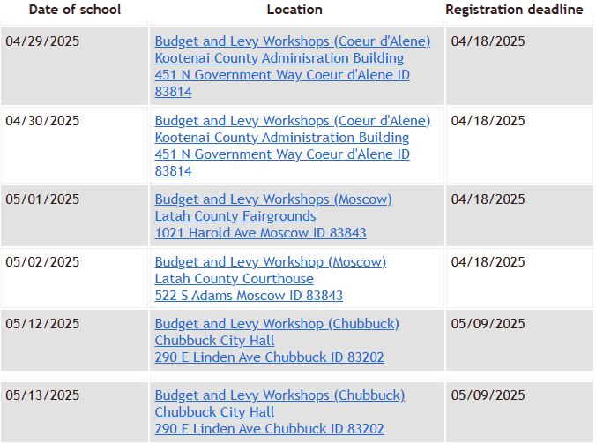
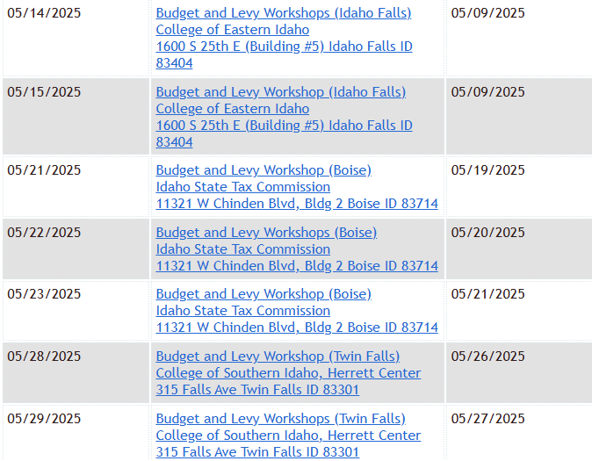
Other – State Tax Commission Budget & Levy Trainings
School District Tax Levy Training by the Idaho State Tax Commission
Link to the State Tax Commission's website: https://apps2-tax.idaho.gov/i-1111.cfm
FY 2026 Public Schools Appropriation
Notes:
Section 29 in H 251

Slide 71
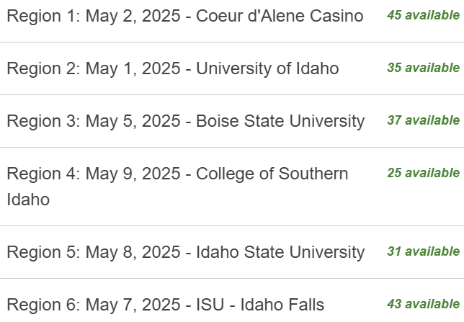
Other – Post Legislative Tour Dates
Region 1 – May 2 in Coeur d’Alene at the CdA Casino
Region 2 – May 1 in Moscow at the University of Idaho
Region 3 – May 5 in Boise at Boise State University
Region 4 – May 9 in Twin Falls at College of Southern Idaho
Region 5 – May 8 in Pocatello at Idaho State University
Region 6 – May 7 in Idaho Falls at ISU – Idaho Falls
Important to attend and registration is required
Still quite a few seats available as of Monday,
April 17 at 9:30 am
FY 2026 Public Schools Appropriation
Notes:
Section 29 in H 251

Slide 72
Other – Public School Finance Contacts
Julie Oberle (208) 332-6840 JAOberle@sde.idaho.gov
Alexandra McCann (Staffing) (208) 332-6845 AMcCann@sde.Idaho.gov
Dean Reich (Attendance) (208) 332-6983 DReich@sde.idaho.gov
Andrew Konopacky (IFARMS) (208) 332-6846 AKonopacky@sde.Idaho.gov
Carol Piranfar (Budgets) (208) 332-6844 CLPiranfar@sde.idaho.gov
Patricia (Trish) Kadri (Auditor) (208) 332-6841 PKadri@sde.Idaho.gov
Amber Worthington (208) 332-6829 AWorthington@sde.Idaho.gov
Ashley Pietras (208) 332-6840 APietras@sde.idaho.gov
Website:
Idaho State Department of Education, School Finance
www.sde.idaho.gov/finance/index.html
FY 2026 Public Schools Appropriation
Notes:
Section 29 in H 251

Slide 73
Questions
Julie Oberle | Public School Finance
208.332.6840
JAOberle@sde.idaho.gov

