Slide 1
Advanced Opportunities
Student Account

Slide 2
Getting Started
WHAT I NEED TO CREATE MY LOGIN AND STUDENT ACCOUNT
Computer
Email Account
Need to know the name of your school district
Need to know the name of your school

Slide 3
Create Your Student Account
CREATE AN ACCOUNT
Important:
You are creating an account you will use during your high school and possibly college years.
Do not guess on your birth year and use your formal legal name.
You must remember your LOGIN information. Store it in a secure document.
It is recommended to use a personal email account (not school email).
Go To Advanced Opportunities Website: https://advancedops.sde.idaho.gov/
Choose “Create Account”
Type in information requested and select “Enroll New Student”
Open your email you provided
Look for email from "No Reply“ and click on “Verify”

Slide 4
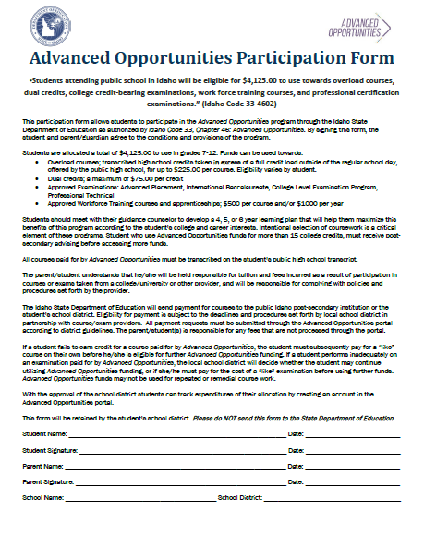
Participation Form
Sign Participation Form (both student and parent/guardian)
Return signed form to the school Advanced Opportunities Designee
Notes:
The Advanced Opportunities participation form must be returned before students can use Advanced Opportunities funding.

Slide 5
School Approval
Once account is created and verified, a school will need to approve and grant access.

Slide 6
Utilizing the Funding
READY TO REQUEST FUNDING
YOU WILL NEED TO KNOW:
Name of your school district
Name of your school
Name of county you live in, not where school is located
EDUID # (your Advanced Opportunities Designee can give you this)
If you do not see your class choice, notify your school Advanced Opportunities Designee. They may need to load them into your school options. Do not create your own names for classes.
Make appointment with school counselor/college & career advisor prior to requesting funding for classes. Classes/Exams should be part of your overall career pathway plan.
Request Funding
https://advancedops.sde.idaho.gov/
Select “Login”
Select “Request Funding”
Talk to your Advanced Opportunities Designee with any questions

Slide 7
Tracking Your Education
View Account Details
https://advancedops.sde.idaho.gov/
Select “Login”
Select “Course Submissions” or “Exam Submissions”
Select “Funding Details”
View Funding Information
University Courses
Exams
High school credits
Money Available

Slide 8
Even More Opportunity!
THE EARLY GRADUATION SCHOLARSHIP
Make appointment with school counselor/college & career coordinator to discuss the option of graduating early and how to qualify.
Go To Advanced Opportunities Website
https://advancedops.sde.idaho.gov/
Select “Login”
Select “Apply for Early Graduation Scholarship”
Answer questions as requested
Important:
Must graduate at least one year early
Must Apply
Attend an Idaho Public College

